Slide 1
Home Screen
The app as it would appear on an iPhone home screen (aka super kawaii)
The name “P-Active” is a pun of sorts on hipster jargon

Slide 2
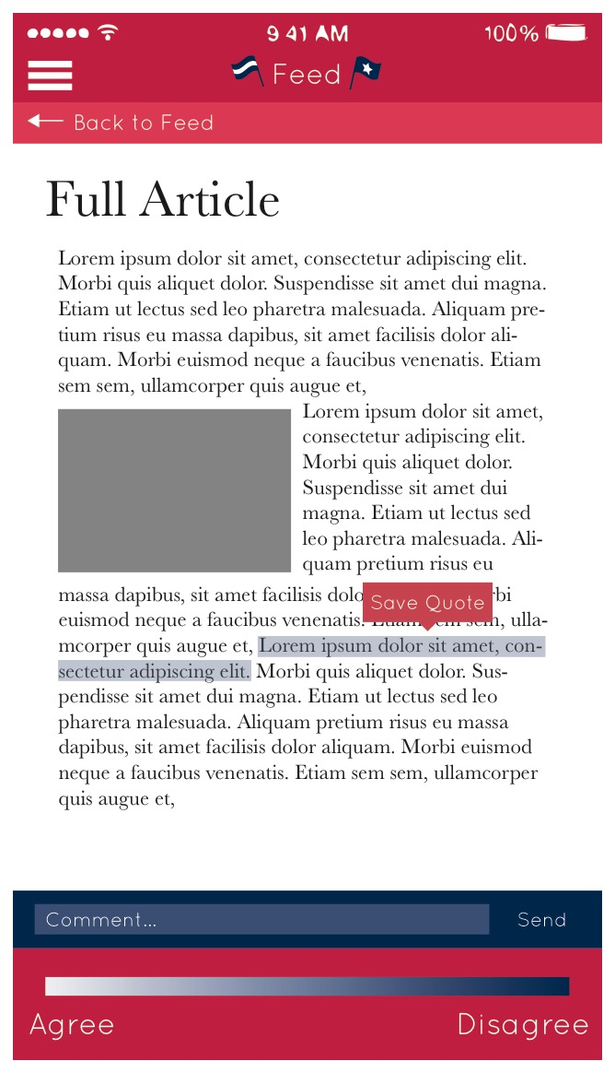
Feed
Upon opening the app, the user would be brought to a news feed. The app would pull articles from only accredited sources and display them on the feed.
The blue dots indicate new articles and will obviously be more numerous than depicted.
Users can select states and counties of interest and save them to their favorites.
The first articles to appear will be on national issues. When users tap on their saved states the map will zoom to that state and local articles will appear. From there, counties can be selected.
Users can “up” articles they like and these will appear first on the feed.
Articles are not limited to print and can include videos with their transcript.

Slide 3
Feed cont’d
When a user selects an article it will appear as it shown on the right.
Users will select quotes, which can be one or more sentences, and then mark whether they agree or disagree.
Within each article is a comments section where users can speak freely.
Users may also save quotes to be used in debate.

Slide 4
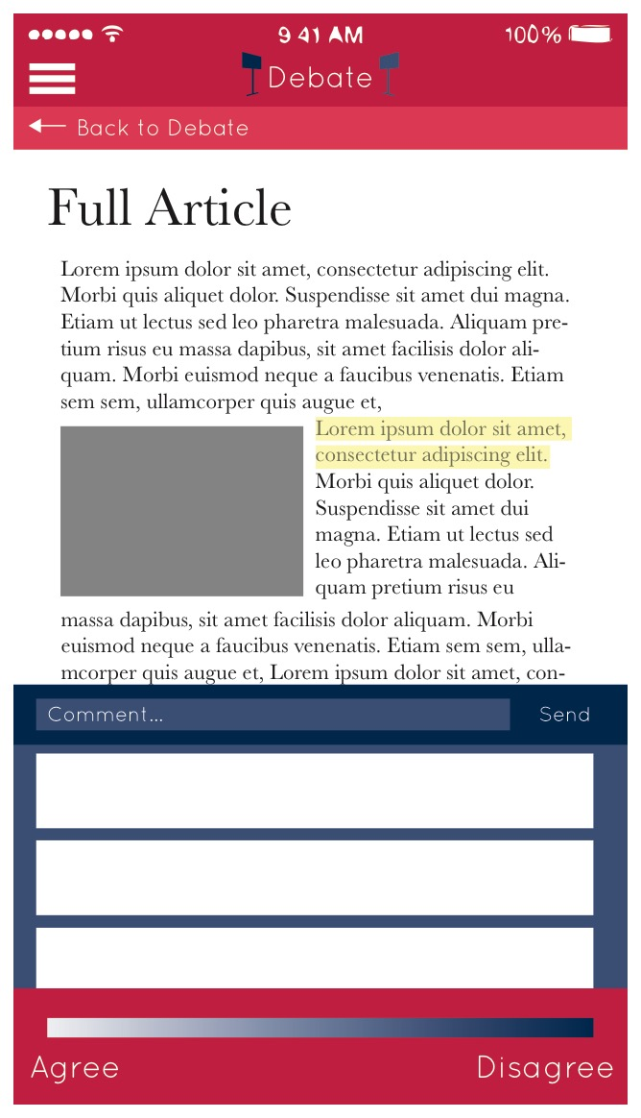
Debate
In the debate tab users submit quotes they like that support their beliefs on relevant issues as shown on the left. Quotes are stacked by the computer according to political party. Users can flip through the quotes like a deck of flashcards.
To agree or disagree with a quote, a user will tap it and it will open inside it’s original article as displayed on the right. The more people agree with the quote, the higher it appears on the stack.
The agree and disagree system is a sliding scale without numbers designed to enhance the user’s freedom of expression.

Slide 5
Stats
The app will also provide users with statistics by region.
The charts, categorized by issue, show which political ideology users agree with most.
The chart is a plot chart with the center being neutral.

Slide 6
Colors
Within one political party there can be multiple political ideologies, therefore P-Active aims to inform users of which ideologies they agree with.
The colors tab displays the political ideologies on a color wheel in relation to four main concepts: totalitarianism, anarchism, egalitarianism and exceptionalism.
Users can tap on each philosophy for an explanation, discussion, and submit whether they agree of disagree with the philosophy much like with any other article.

Slide 7
Rally
Though not as visually developed at the moment, the rally tab is an important part to P-Active’s appeal.
Very integrated with Facebook, this tab will display current and upcoming politicians’ profiles and gives them a platform to communicate with supporters.
Verified politicians can post articles and events to their page to both help them get elected, and inform citizens of policies and achievements while they are in office.

Slide 8
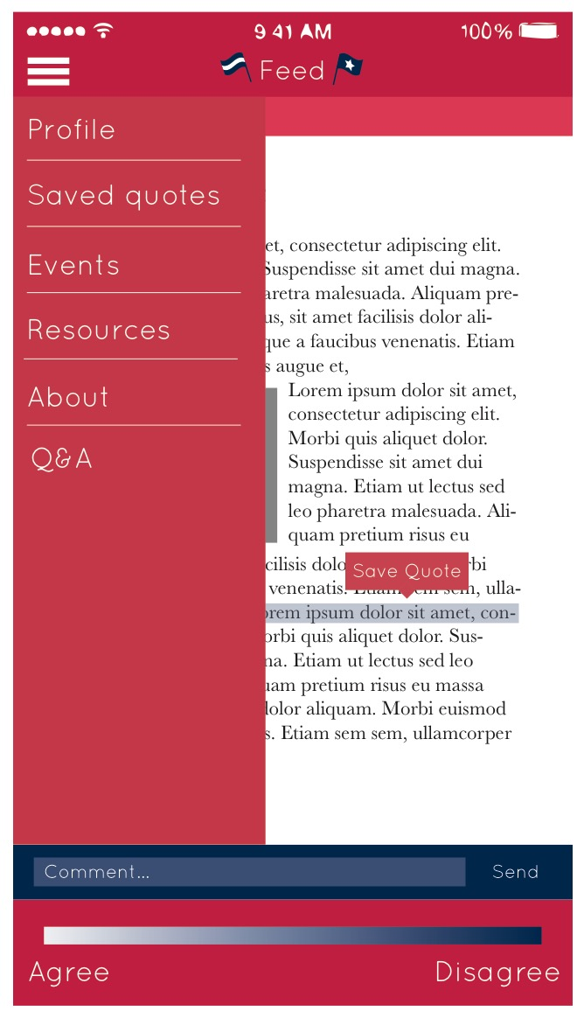
Side Menu & Resources
The side menu lets users navigate to their profile, saved quotes, and events.
In addition, the resources tab provides users with easy access to important political documents like the Declaration of Independence, the Constitution, Bill of Rights, and all the Supreme Court cases.
Users can save quotes from any of these documents as well.

